Slide 1
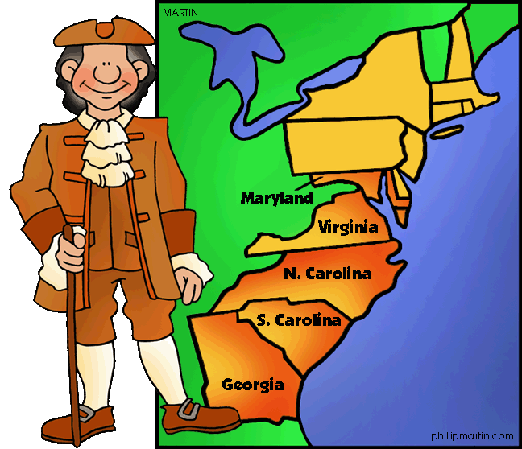
The Southern Colonies

Slide 2
Virginia
Started with Jamestown (1607)
Reasons for success
John Smith said “No work, No food”
Tobacco become a cash crop

Slide 3
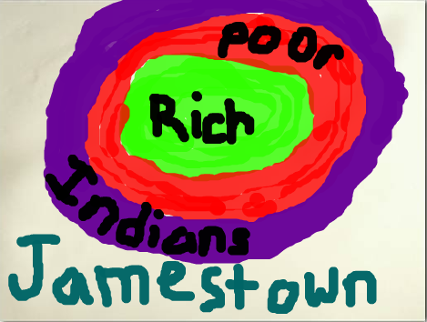
Bacon’s Rebellion (Continued)
America’s First (almost) Revolution
First evidence of Racial discrimination.

Slide 4
Bacon’s Rebellion (Continued)
Settlers moved west into Native American lands—Fighting Erupted
Farmers ask the Governor for help and he refuses.
Nathaniel Bacon—organizes a raid kills peaceful Indians, he then tries to overthrow the Governor.

Slide 5
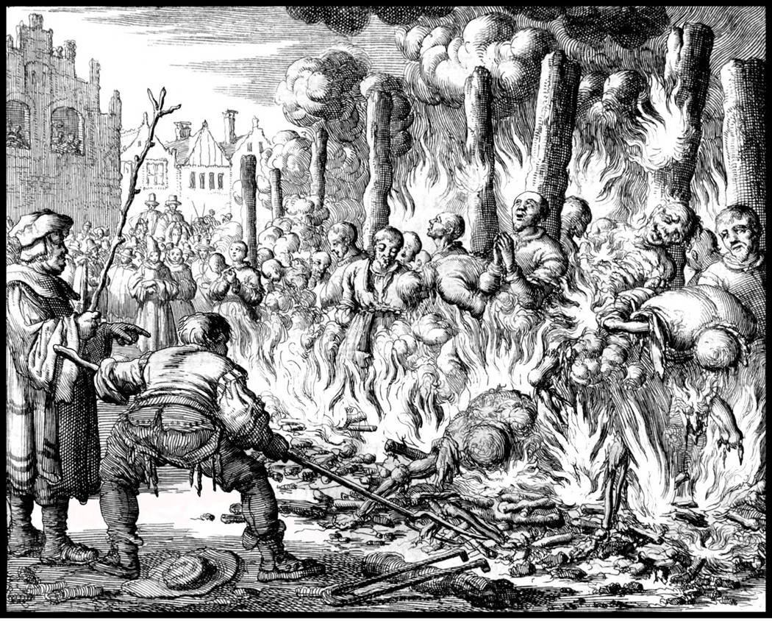
Maryland
1632
Catholics in England were getting Persecuted.
Act of Toleration –Guaranteed freedom to all Christians (but no one else)

Slide 6
The Carolinas
1663
Northern Carolina—mostly small tobacco farmers moving south from Virginia
Southern Carolina—mostly large plantations
Grew rice and cotton
Slavery begins to grow
South Carolina becomes own colony in 1712

Slide 7
Georgia
1733
England’s prisons are overflowing
In prison because they are broke, they are broke because they are in prison…
Spain has a colony in Florida
Maybe they’ll attack!
WIN-WIN—let colonists make money and hold off Spain until the army arrives.

