Slide 1
Life in the Colonies
Was the American Revolution avoidable?

Slide 2
Geographically
Economically
Politically
Socially

Slide 3
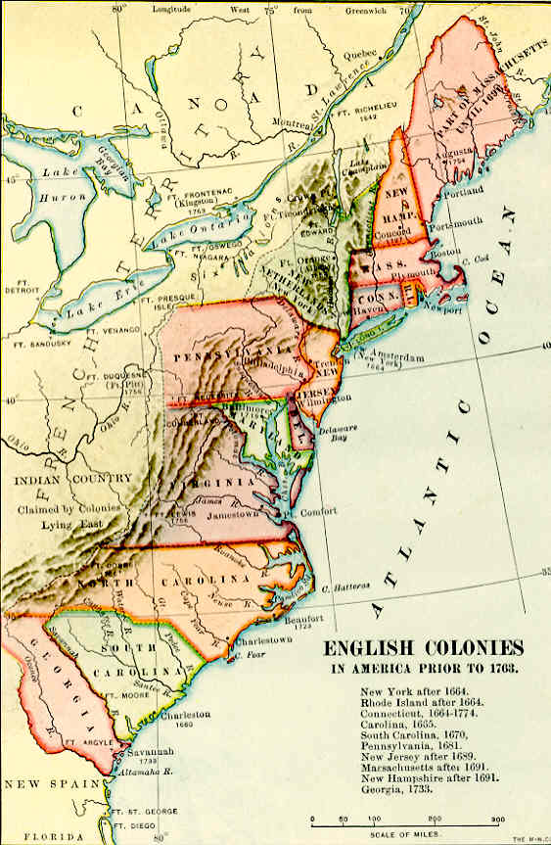

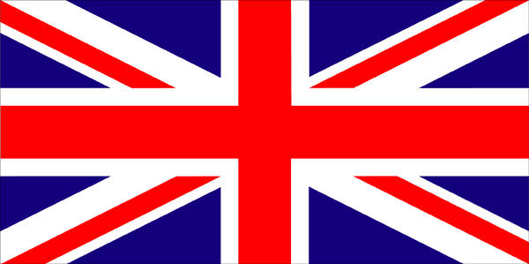

Geography
Appalachian Mountains form a natural wall

Slide 4
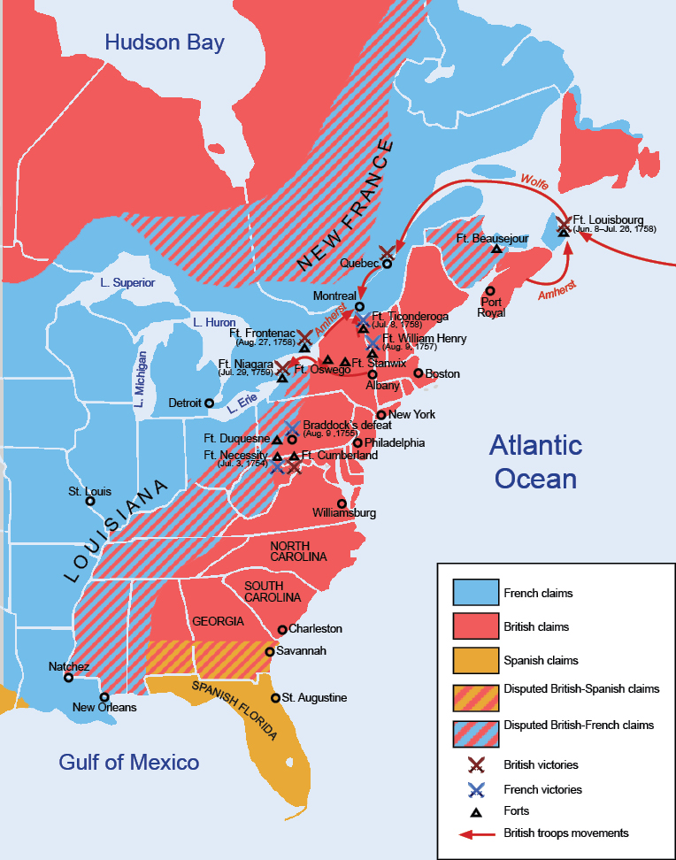
Geography
The French are in the American interior, trading furs.
This will lead to conflict.

Slide 5
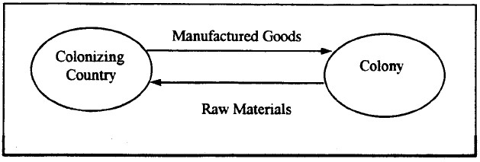
Economy
Mercantilism—economic system where a country gains $$ by using colonies for raw materials and sells finished goods back to them.

Slide 6
Economy
Navigation Acts—made it illegal for the colonies to trade with other countries (can’t get the best price)
Triangular Trade—the trade between the Americas (raw goods), Europe (finished goods), and Africa(slaves)

Slide 7
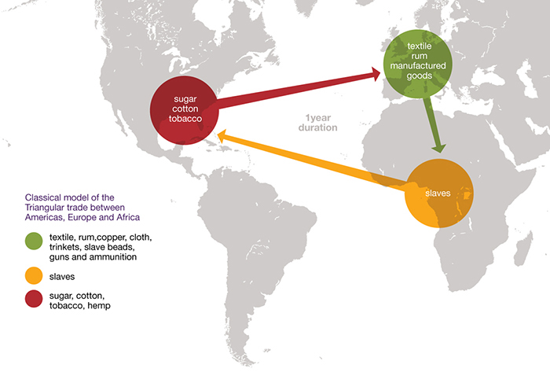

Slide 8
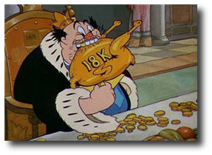
Political
Salutary Neglect—King George III doesn’t really enforce Navigation Acts. The colonists make things work on their own.
Piracy becomes popular

Slide 9
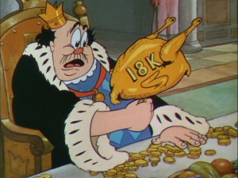
Politics
House of Burgesses—Jamestown; colonists elected representatives to make decisions
(Congress? Self-Government? American Independence?)

Slide 10
Social Changes
First Great Awakening (1734-1735)—
  a revival of religion in America that moved many away from the British Anglican Church.
  Uniquely American, helped create the idea of an “American” culture.

Slide 11
Social Changes
The Enlightenment
  A movement to find answers in science and reason (as opposed to religion)
  Challenged basic ideas of where a government gets its power.

