Slide 1
From Poland to Pearl Harbor
World War 2 before the USA joined the fight.
http://www.historyanimated.com/wwiianimated.com/BritainAnimation.html

Slide 2
Germany Invades Poland
Sept. 1, 1939
Hitler uses a new style of warfare: BLITZKRIEG
  Means “Lightning War”
  Use of speed and surprise—THE PERFECT COORDINATION OF TECHNOLOGY AND TECHNIQUE—to overwhelm the enemy.

Slide 3
Blitzkrieg—Lighting War

Slide 4
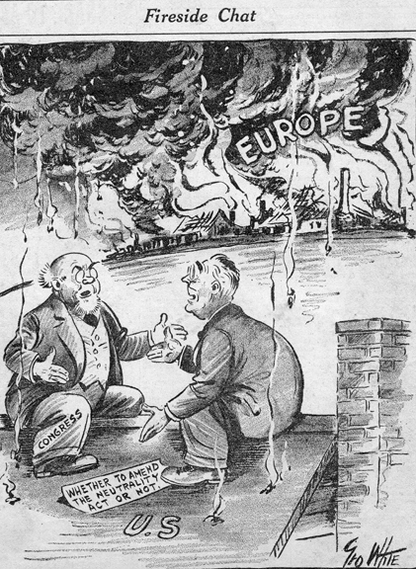
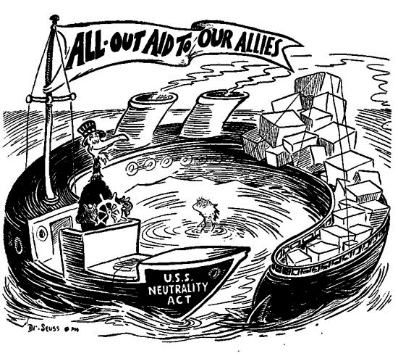
USA stays Neutral
Neutrality Acts—banned selling weapons and loaning money to countries fighting in Europe.

Slide 5
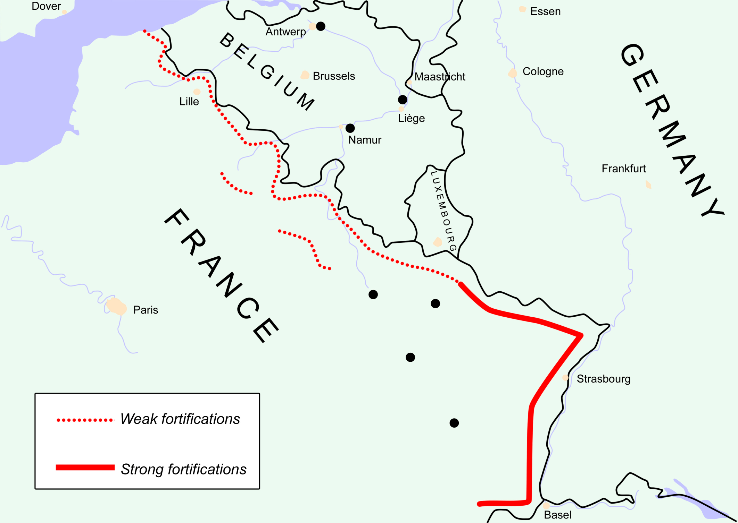
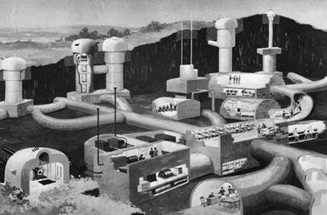
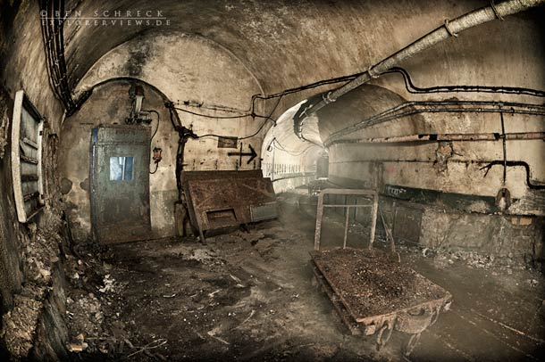
Maginot Line
After WWI, France built heavy defenses along the border with Germany.
The sent their troops and waited for Hitler to attack
Instead Hitler BLITZKRIEGed Denmark and Norway, then Belgim and the Netherlands.

Slide 6
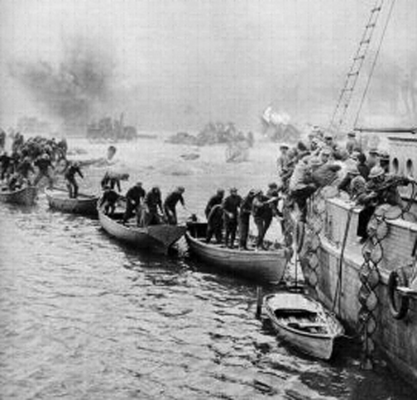
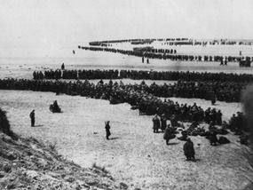
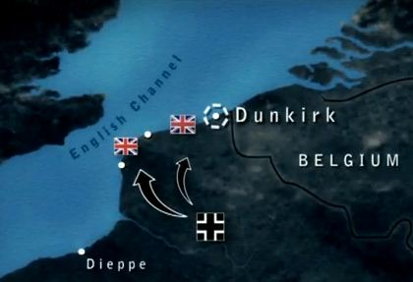
Miracle at Dunkirk
Trapped between the English Channel and the German Blitzkrieg, Allied forces were exposed to be slaughtered.
Using Warships, ferries, fishing boats—more than 300,000 French and British Soldiers were Rescued.

Slide 7
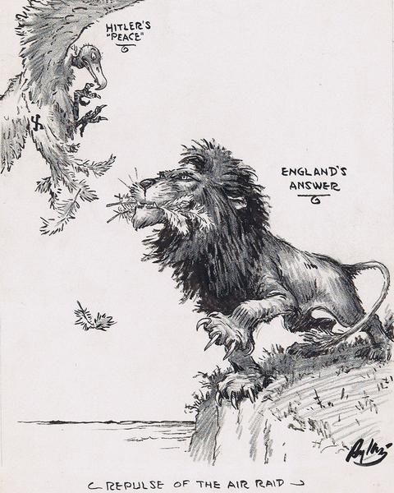
Battle of Britain
Hitler, undefeated, is now only 40 miles away from the last democracy in Europe; he turns his entire efforts to destroying Britain.
Hitler’s first defeat of the War

Slide 8
Lend-Lease Act
Seeing Britain backed into a corner, the USA decides it will:
  Give battleships and supplies to England in exchange for leasing military bases in the Caribbean.

Slide 9
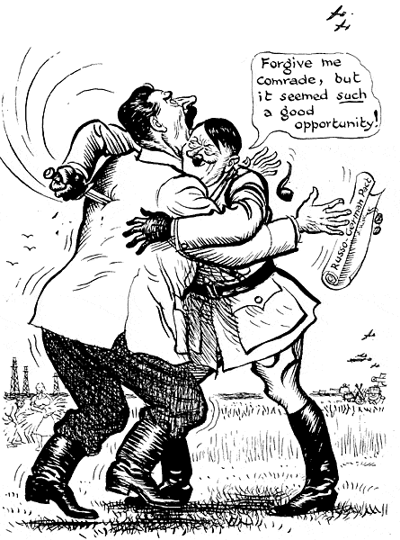
Hitler Turns on Stalin
Britain is Crumbling, USA is an ocean away.
The USSR is the threat to Hitler’s war machine; and the last obstacle to conquering the Continent.
1941 Hitler breaks his promise to Stalin and invades the USSR

Slide 10
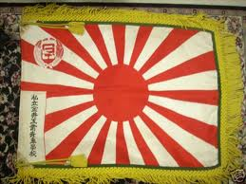
Meanwhile on the Other side of the World….

Slide 11
Pearl Harbor
After Japan invaded China, the USA stopped trading oil and other supplies with them—Japan is quickly running out.
To be ready to meet the threat, the USA moves the Pacific Fleet of its Navy to Pearl Harbor, in Hawaii.
Japan has conquered nearly all of the Pacific, the USA is the only…

