Slide 1
French & Indian War
French vs. English

Slide 2
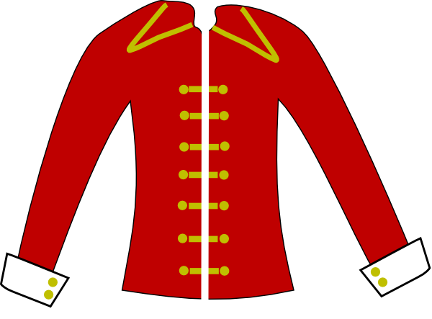
New World
Your Rivals
France
World War 0
7 Years War
Queen Anne’s
King William’sWar
French & Indian
War
King George’s War
Great
Britain

Slide 3
The War between BRITAIN and FRANCE to control the NEW WORLD by using Native American allies otherwise called the:
French & Indian War

Slide 4
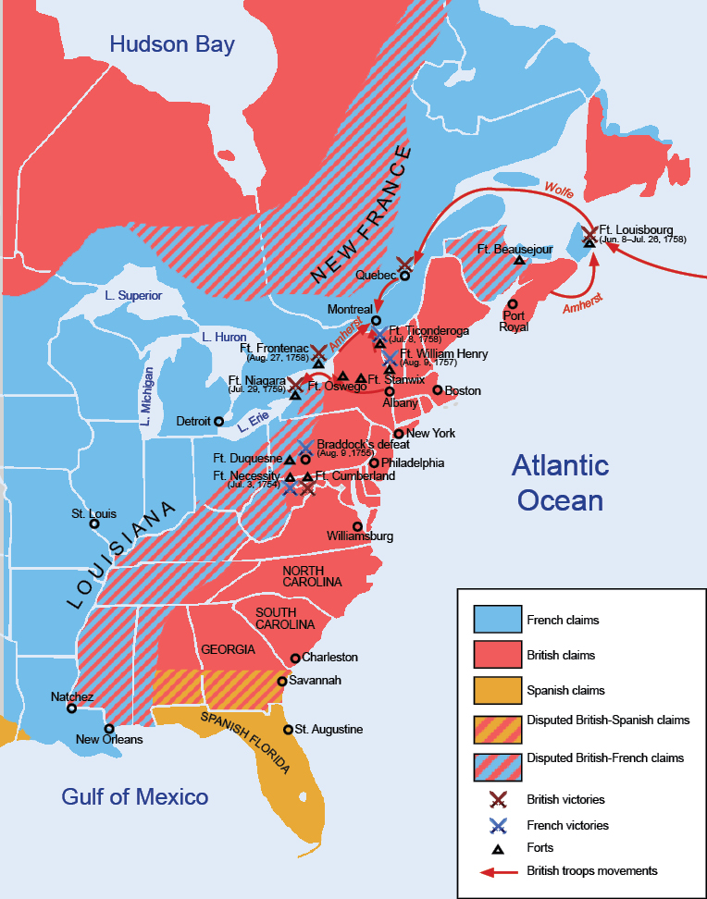
What French Forts would anger the Brits most?

Slide 5
French in
North
America
British in North America
Native Americans

Slide 6
Causes of the F&I War.
Land
Fur Trade
Indian Relations

Slide 7
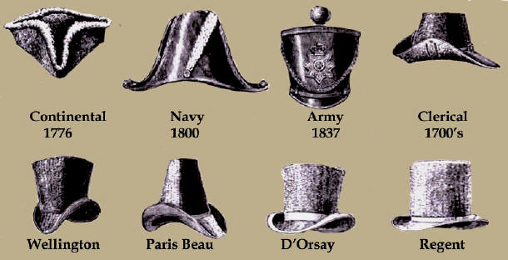
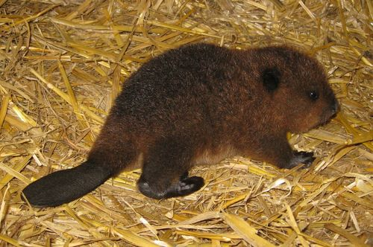
Cause 1: Fur Trade
Frances most important New World Industry
Beaver Fur is used to make hats (1500’s-1800s)

Slide 8
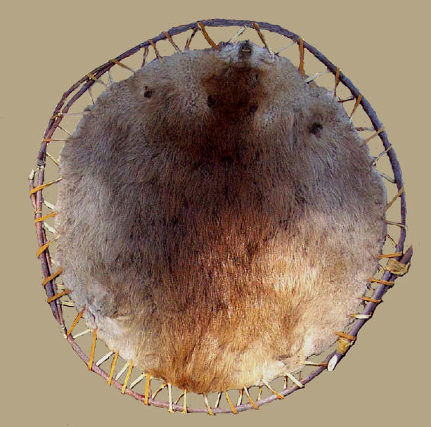
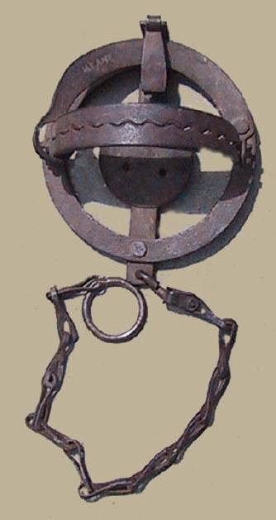
Beaver Fur
Beaver Trap

Slide 9
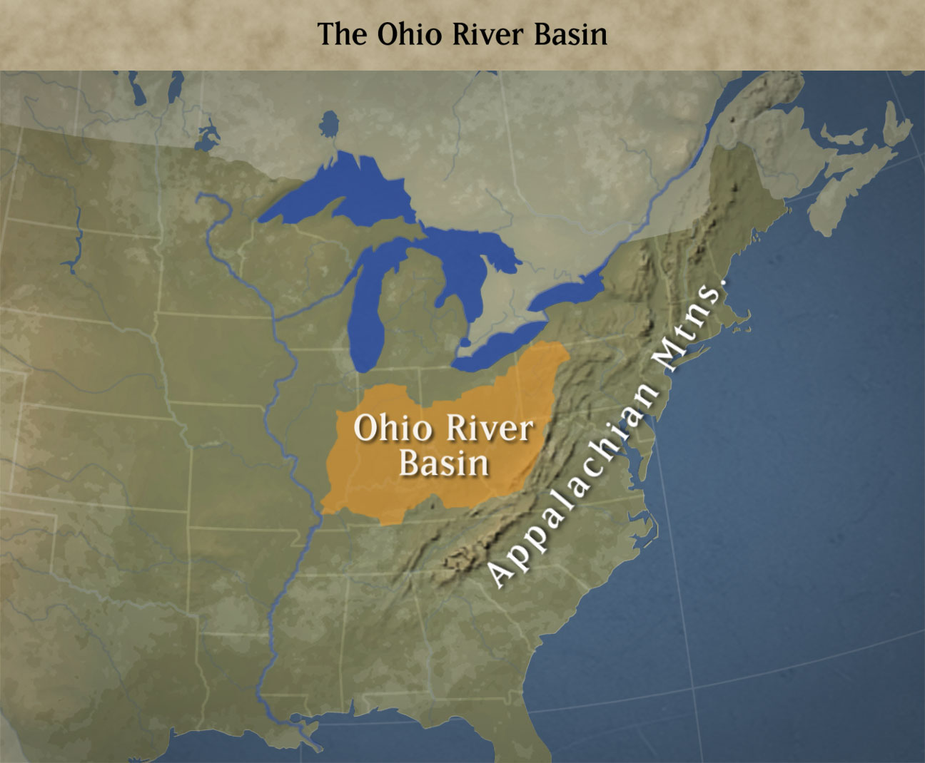
Cause 2: LAND
English bought 500,000 acres of the Ohio River Valley to turn into farmland.
This would hurt the French Fur trade.

Slide 10
Cause 2: Land
French build forts to protect their trade.

Slide 11
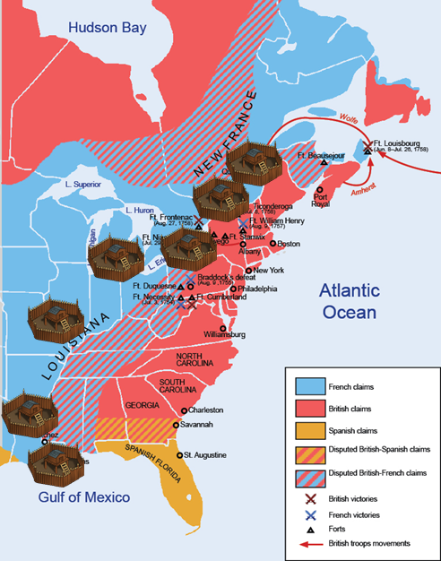
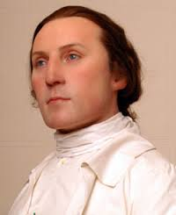
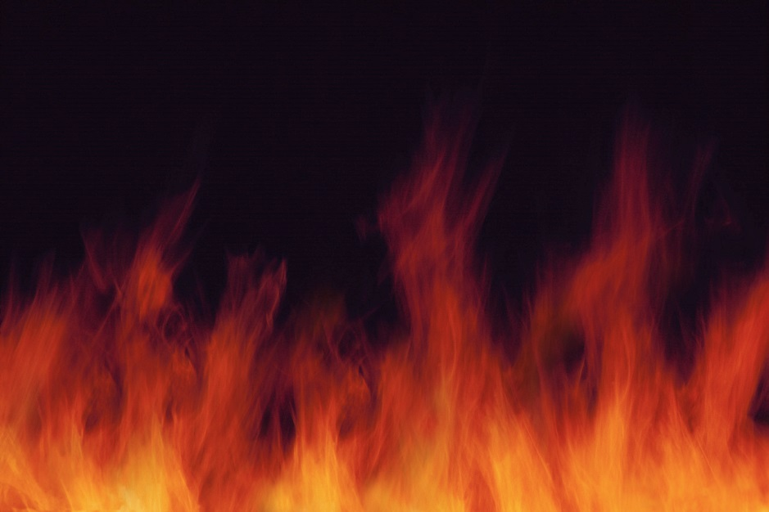
Attack on Ft. Duquesne
George Washington is sent to drive out the French Forces

Slide 12
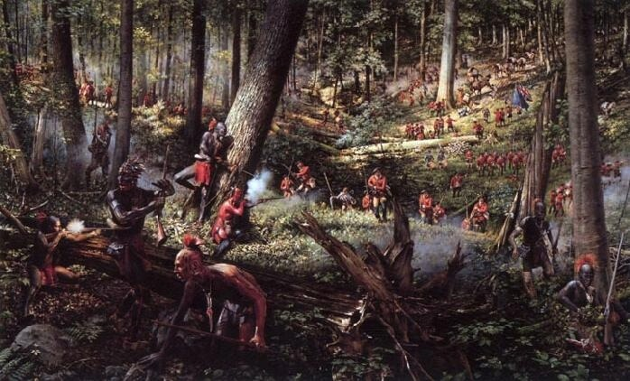
Start of French and Indian War

Slide 13
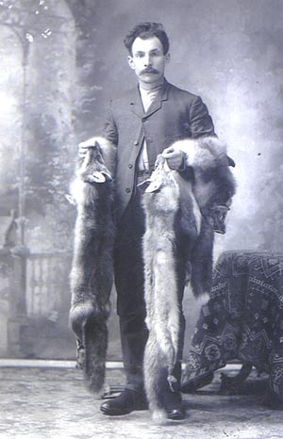
Cause 3: Indian Relations
French have a better relations with Natives
French just want Fur
British want the land

Slide 14
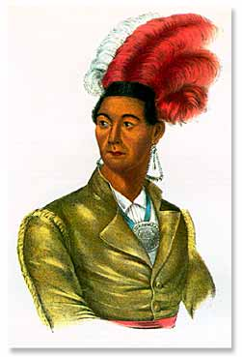
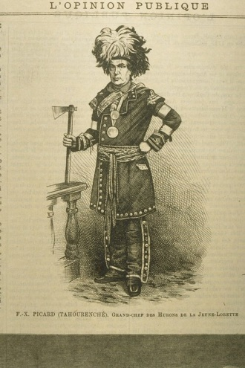
Native American Involvement
1. British/American Colonies
A. Iroquois League
1. Mostly neutral
B. Chief of the Mohawks
Joseph Brant
Became a colonel in the British army.
2. French Colonies
A. Algonquins, Ottawas & the Hurons
1. Longtime trading partners
2. Didn’t trust the land grabbing white settlers.

Slide 15
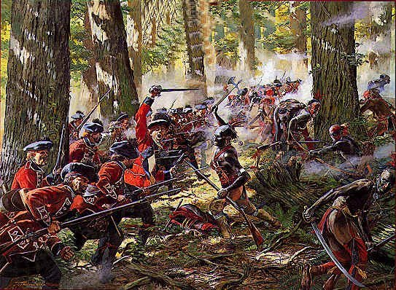

Slide 16
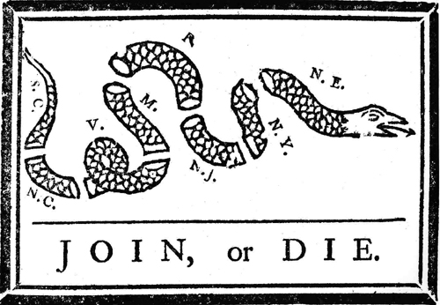
The Albany Plan
B
E
N
F
R
A
N
K
L
I
N
Ben Franklin’s Idea, 1754
Would unite the colonies into 1 “country” in terms of defense, taxes, and leadership
Turned down by the colonies and the King

Slide 17
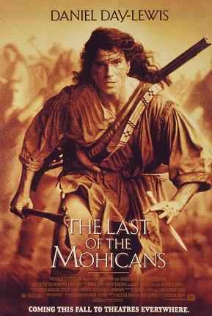
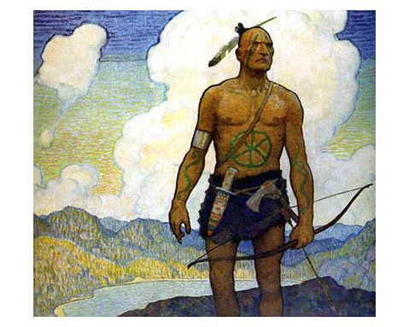
The Last of the Mohicans
Written by James Fenimore Cooper
The Last of the Mohicans is part of a series of four books called The Leatherstocking Tales.
Follows the life of a colonial boy and his Native American friend.

Slide 18
Battle of Quebec
Turning Point of War
British approach Quebec by sea and climb cliffs-surprise attack
Plains of Abraham
French caught off guard.

Slide 19
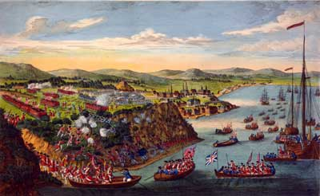

Slide 20
Battle of Quebec
Commanders of both armies die in battle
G. British claim victory
H. French surrender
British General-James Wolf’s death at Quebec

Slide 21
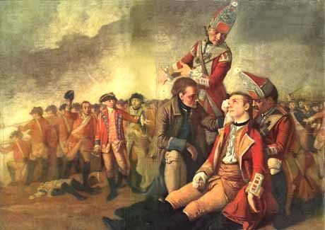
General Wolf
Mortally Wounded

Slide 22
Treaty of Paris 1763
Ends the War
France gives up all land in North America to Britain
Colonies are now everything east of the Mississippi River and also Spanish Florida.

Slide 23
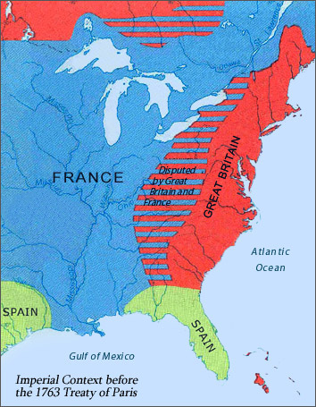
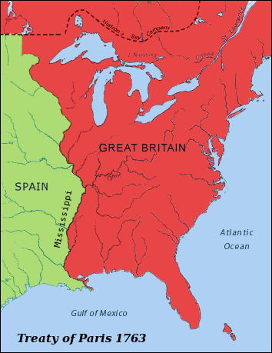

Slide 24
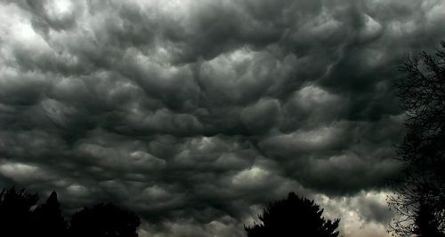
Britain owes a lot of money.
Decide to re-establish control in the colonies.

