Slide 1
America’s First Colonies
Essential Question: What were the first European Settlements in the New World

Slide 2
The New World
???
European kings invested in exploration for GOLD, GOD, and a WATER ROUTE to Asia.
The New World offered the promise of all three.
      Aztec Empire held vast amounts of Gold
      60 million native peoples could be converted
      Water Route could still be discovered.

Slide 3
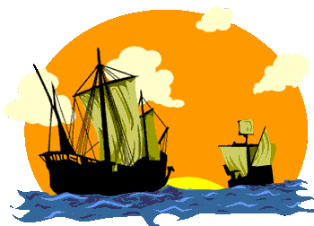
Direct Causes = 3 G’s Glory, Gold, and God
Political: Make your country stronger by gaining wealth and land. (set up colonies) (GLORY)
Economic: Make your country wealthy by finding a a water route to Asia’s spice trade (GOLD)
Religious: spread Christianity. (GOD)

Slide 4
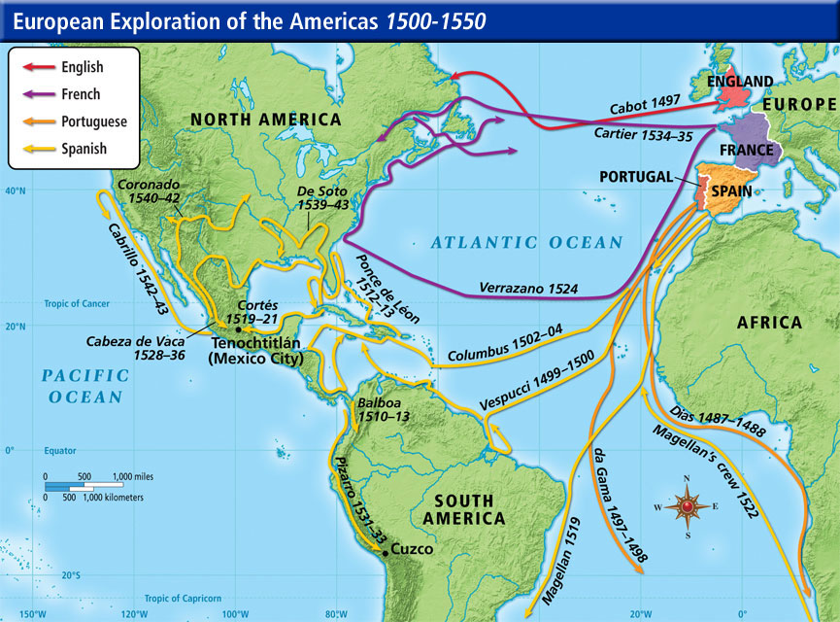
Who seemed to explore the America’s the most extensively?

Slide 5
Spain
Colonizes Mexico and South America (Aztec and Inca gold)
Explore North America looking for deep rivers to the Pacific, Cities of Gold, and the Fountain of Youth

Slide 6
Ponce de Leon

Slide 7
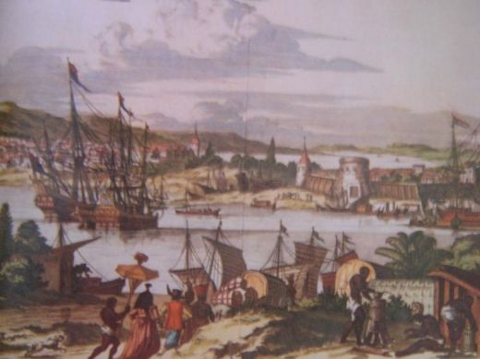
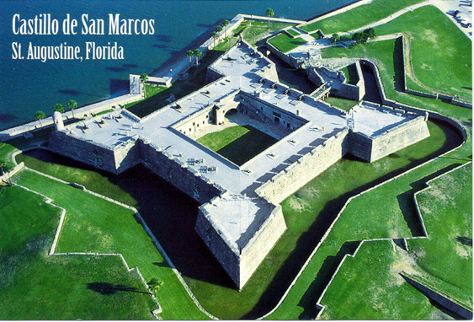
St. Augustine, Florida
The oldest, permanent European settlement in North America, 1565
Suffered several attacks by pirates, the English, and Indians

Slide 9
England
Wants to gain wealth like Spain
Needs more natural resources to feed its industry.

Slide 10
Mystery of Roanoke
1585, Sir Walter Raleigh attempts to colonize the Island of Roanoke, Virginia. It fails.
1587, tries again with 117 people. When Raleigh returns 3 years later, nothing is there, everybody is gone, with no clues but the world “CROATOAN” carved on a tree.

Slide 11
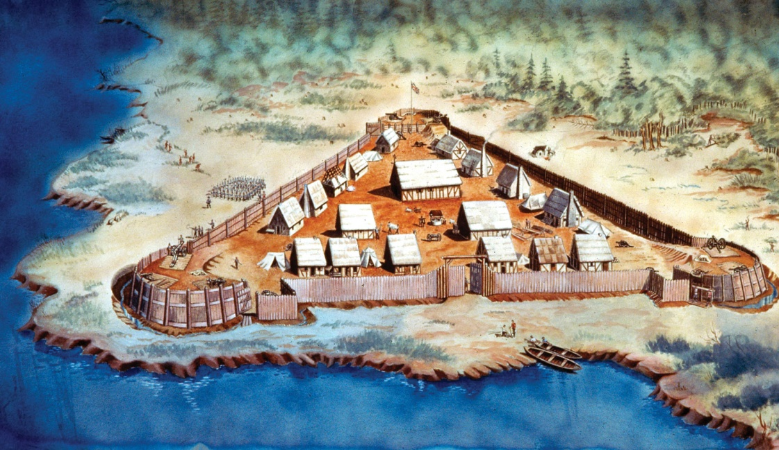
Jamestown, VA
1st permanent English settlement, 1607
Faced many hardships
  Hostility AND friendship with Indians
  John Smith lead them to survival

